Slide 1
Database System Tutorial 1
Notes:
Welcome everyone

Slide 2
Compare SQL Joins
Cartesian Product (×)
Theta Join (⋈_{θ})
Natural Join (⋈)
Key Differences
Notes:
Today, we’re going to explore three types of relational operations often referred to as ‘joins’ in SQL and relational algebra: the Cartesian Product, the Theta Join, and the Natural Join. We’ll look at what each one does, how they differ from each other, and in which scenarios you might use them. By the end of this session, you’ll have a clear understanding of these fundamental concepts in database systems.

Slide 3
Cartesian Product (×)
Join with no condition
Yields every combination of values
All attributes concatenated
Notes:
“The Cartesian Product is the simplest form of combining two tables or relations. It’s denoted as r×sr \times sr×s in relational algebra. What it does is pair each row from the first table with each row from the second table—no conditions, no filters.

Slide 4
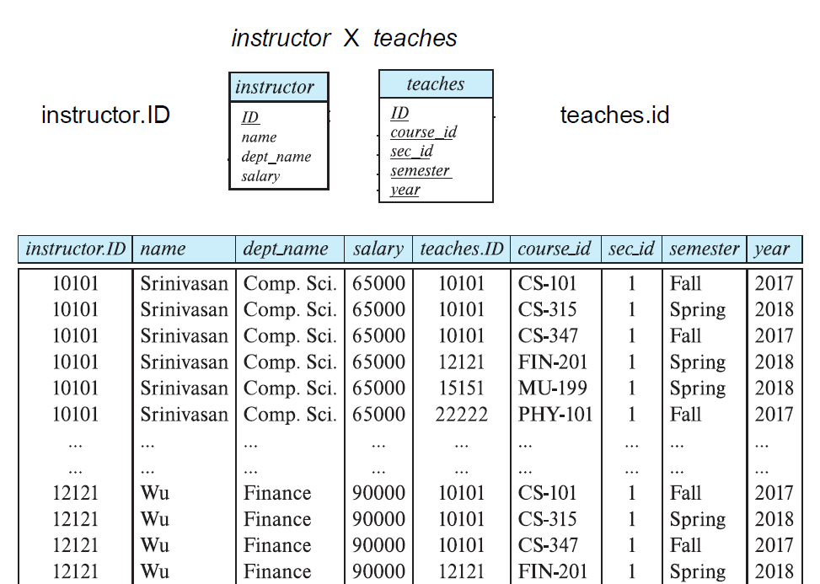
Notes:
If table A has m rows and table B has n rows, the result will have m × n rows. This can grow very large, so we typically don’t use the Cartesian Product by itself in real queries. Instead, it’s often the foundation for other join operations, where we add conditions to filter out rows.”

Slide 5
Theta Join (⋈_{θ})
Cartesian Product, but with extra predicate
r ⋈_{θ} s = σ _{θ}(r × s)
σ_{instructor.ID=teaches.ID}(instructor × teaches)
=
instructor ⋈_{instructor.ID=teaches.ID} teaches
Notes:
“A Theta Join is a Cartesian Product combined with a condition (often called a ‘theta’ condition). In relational algebra, we write it as r⋈θsr \bowtie_{\theta} sr⋈θ​s, which is the same as performing a Cartesian Product r×sr \times sr×s and then applying a selection σθ\sigma_{\theta}σθ​ that filters out rows not meeting the condition. The condition can use any relational operator—equality, inequality, greater than, etc. In typical SQL, the most common form is an equi-join, where we match on a specific column like instructor.ID = teaches.ID.”

Slide 6
Natural Join (⋈)
Cartesian Product, but automatically uses = for each column with the same name
instructor ⋈ teaches
=
σ_{building=303 ∧ year=2024} (instructor × teaches × department)
Notes:
“A Natural Join is another special kind of equi-join. It looks at all columns that share the same name in both tables and automatically creates equality conditions on those columns. This can simplify queries, because you don’t have to explicitly write each matching condition. However, you need to be cautious. If two tables share a column name that you don’t intend to match on, you could end up filtering rows incorrectly. That’s why Natural Joins can be convenient but should be used with an awareness of the schema design.”

Slide 7
Key differences
Cartesian Product (×): No condition, pairs all
Theta Join (⋈_{θ}): plus predicate
Natural Join (⋈): automatically join matching cols
Notes:
**“To wrap up, remember these key differences:
Cartesian Product: Just pairs every row from one table with every row from another. Usually needs filtering.
Theta Join: Allows any condition, including equality, inequality, or more complex predicates.
Natural Join: Automatically uses equality on all columns with the same name. Convenient, but be cautious of unintended matches. Always choose the type of join that best fits the relationship you need to express. This ensures both clarity and efficiency in your database queries.”**

Slide 8

FIN
Any questions?

